Slide 1
Problem 1.11 – On Gaussian Distribution

Slide 2
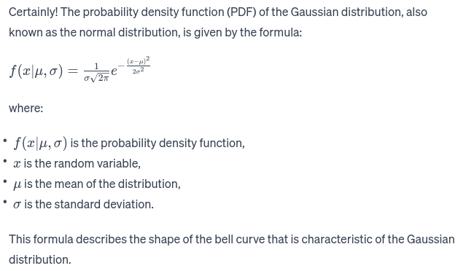
Can you give me the equation for Gaussian distribution?

Slide 3
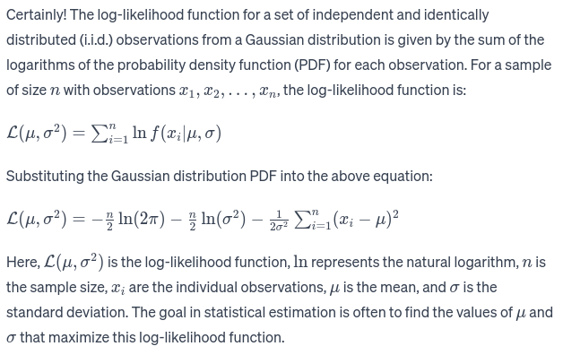
Can you give me it's log likelihood function?
Note: This is already given as part of the problem statement.

Slide 4
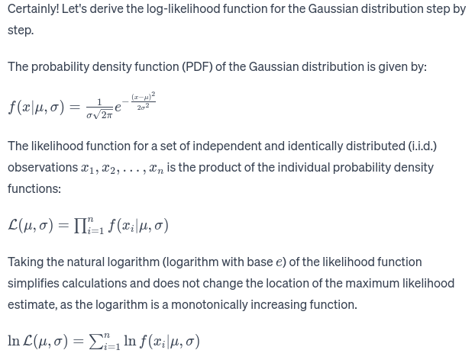
Can you show the detailed steps how you arrived at it?

Slide 5
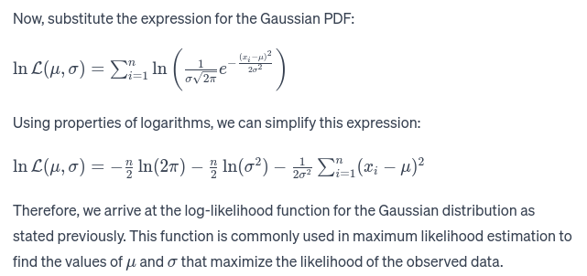

Slide 6
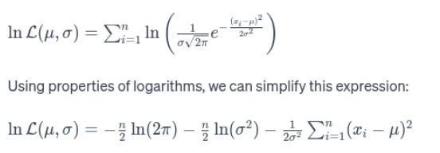

Some paperwork
In the next slide we will solve for the below expression:

Slide 7
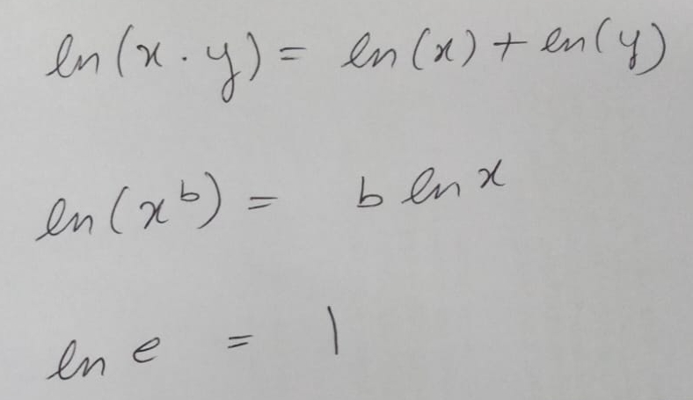

Slide 8
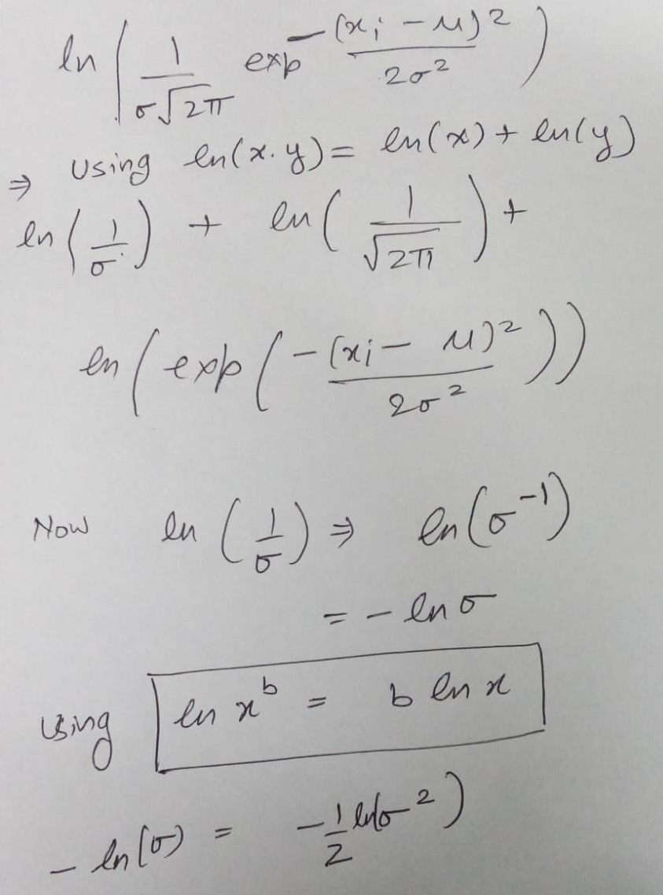

Slide 9
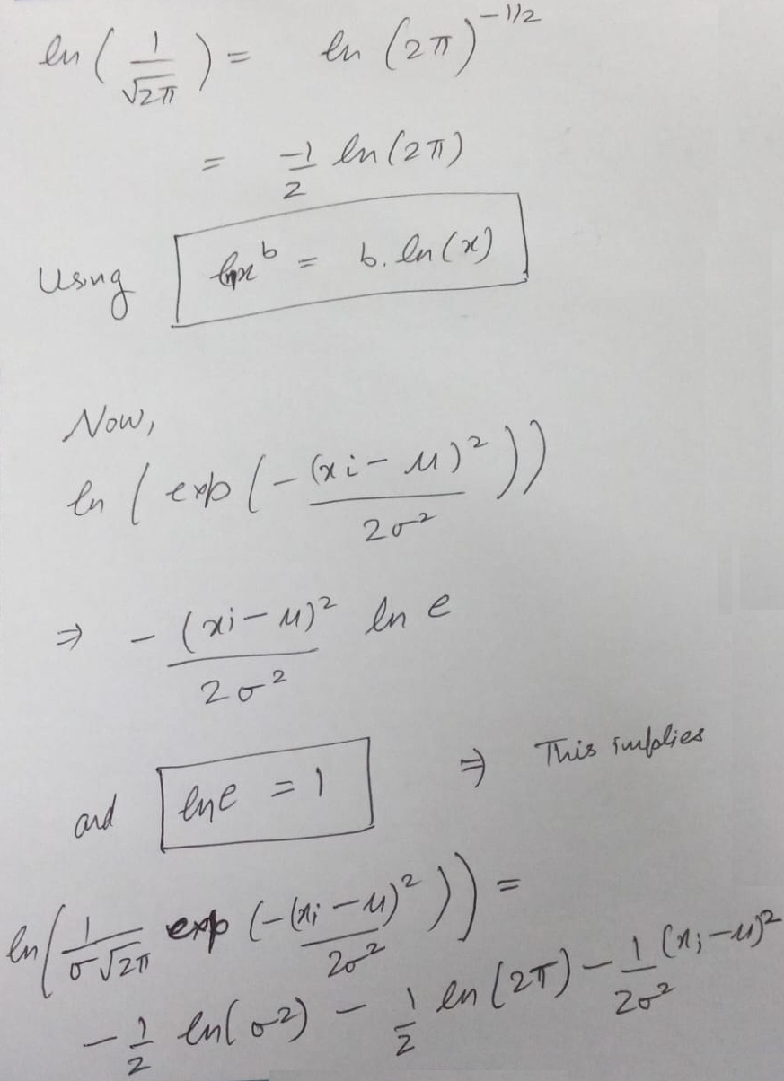

Slide 10
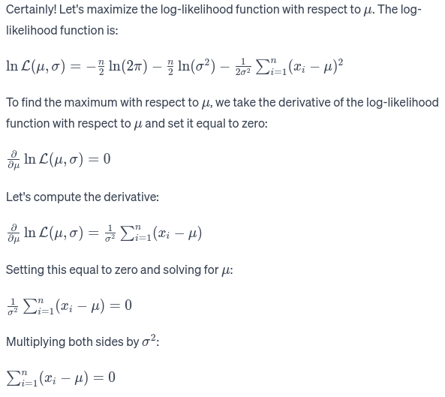
Can you maximize the log likelihood expression w.r.t. mu and show the detailed steps?

Slide 11
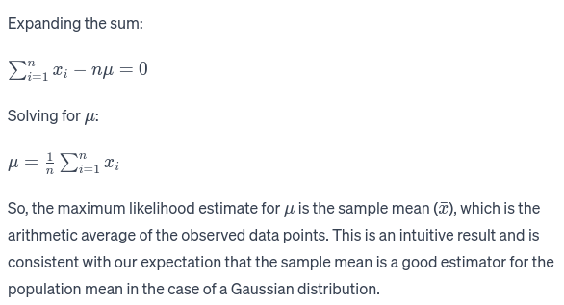

Slide 12

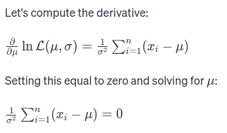
Some paperwork for derivative of:
We will prove it next:

Slide 13
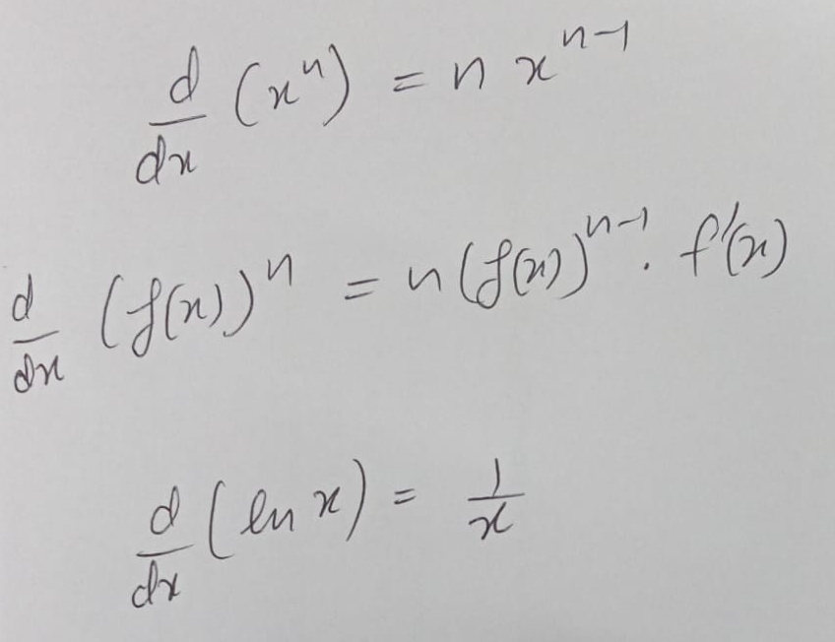
Some ‘Differentiation’ identities we would see next

Slide 14
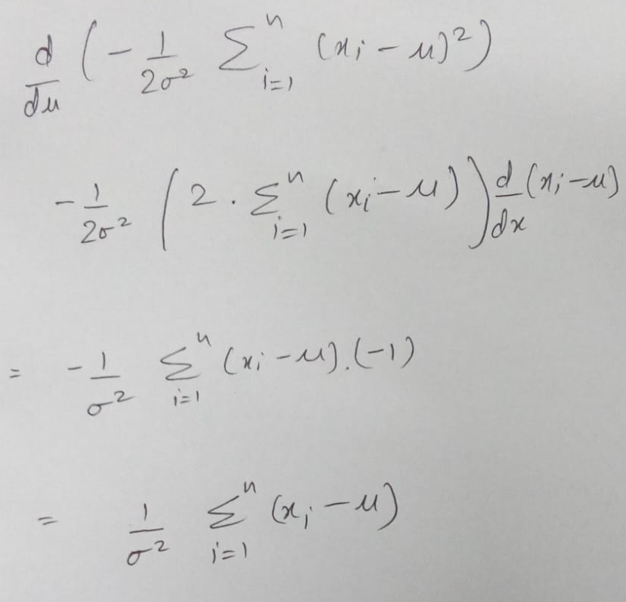

Slide 15
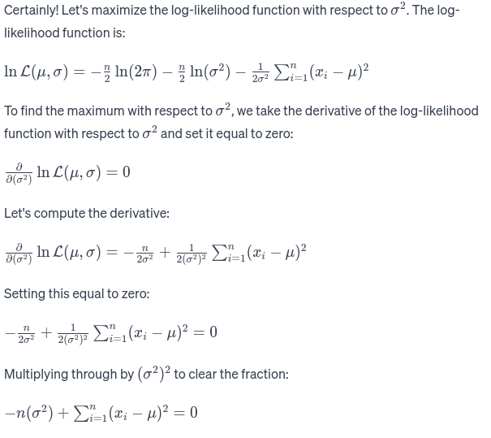

And now maximize log likelihood w.r.t. sigma-squared and show the detailed steps

Slide 16
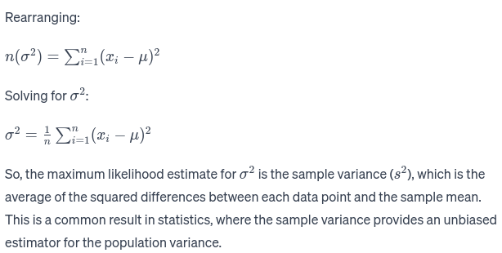

Slide 17
References
https://chat.openai.com/share/4278db33-9b76-4d8b-9586-4e1e78844433

